Slide 1
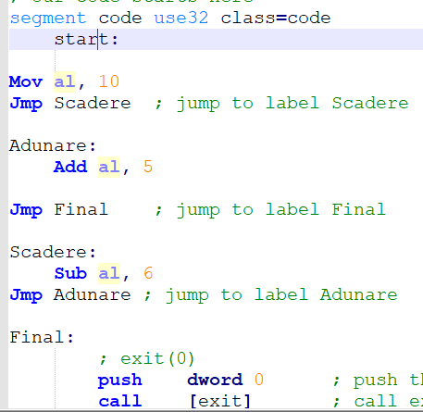
jmp — Unconditional Jump
Transfers program control flow to the instruction at the memory location indicated by the operand.
Syntax:
jmp <label>

Slide 2
CMP Instruction
The CMP (compare) instruction performs an implied subtraction of a source operand from a destination operand. Neither operand is modified:
Syntax: CMP destination, source ; destination-source is performed
destination: reg, mem
source: reg, mem, imm
destination and source – same dimensions
The CMP instruction changes the Overflow, Sign, Zero, Carry, Auxiliary Carry, and Parity flags according to the value the destination operand would have had if actual subtraction had taken place.
Usually a CMP instruction is used follows by a conditional jump.
Notes:
Having examined all of the bitwise instructions, let’s now turn to instructions used in logical (boolean) expressions. At the heart of any boolean expression is some type of comparison. The following pseudocode examples support this idea:
if A > B then ...
while X > 0 and X < 200 ...
if check_for_error( N ) = true then
In Intel assembly language we use the CMP instruction to compare integers. Character codes are also integers, so they work with CMP as well.
The CMP (compare) instruction performs an implied subtraction of a source operand from a destination operand. Neither operand is modified:
CMP instructions syntax is destination,source
CMP uses the same operand combinations as the AND instruction.

Slide 3
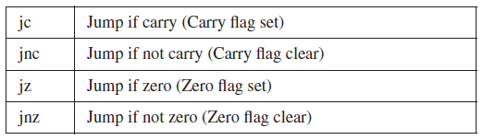
Jcond Instruction
A conditional jump instruction branches to a destination label when a status flag condition is true.
Otherwise, if the flag condition is false, the instruction immediately following the conditional jump is executed.
The syntax is as follows: Jcond destination
cond refers to a flag condition identifying the state of one or more flags
The following examples are based on the Carry and Zero flags:
Notes:
A conditional jump instruction branches to a destination label when a status flag condition is true.
Otherwise, if the flag condition is false, the instruction immediately following the conditional jump is executed.
The syntax is as follows: Jcond destination
cond refers to a flag condition identifying the state of one or more flags
The following examples are based on the Carry and Zero flags:

Slide 4
Cmp destination, source Jcc = jump if destination is in relation (set by jcc) with source.
Code Instruction in ASM (”here” represents a name for a label in code) | Conditional Jumps (Jcc) |  | Relation tested between destination and source | Meaning
 | Signed comparison | Unsigned comparison
cmp destination, source JE here | JE | JE | destination = source | If destination = source then go and execute the code from label here
cmp destination, source JNE here | JNE | JNE | destination ≠ source | If destination ≠ source then go and execute the code from label here
cmp destination, source JG here ; or JA here | JG | JA | destination > source | If destination > source then go and execute the code from label here
cmp destination, source JL here ; or JB here | JL | JB | destination < source | If destination < source then go and execute the code from label here
cmp destination, source JGE here ; or JAE here | JGE | JAE | destination ≥ source | If destination ≥ source then go and execute the code from label here
cmp destination, source JLE here ; or JBE here | JLE | JBE | destination ≤ source | If destination ≤ source then go and execute the code from label here
When comparing two signed numbers, the terms "less than" and "greater than" are used, and when comparing two unsigned numbers, the terms "below" and respectively "above" are used.
The entire list of Conditional Jumps according to Intel IA32 instructions is here: https://www.intel.com/content/www/us/en/developer/articles/technical/intel-sdm.html (starting with page 1058)

Slide 5
Exemples: cmp and Jcc
if a mod 2 = 0 then rez = a*3, a-byte
Unsigned | Signed
mov al, [a] | mov al, [a]
mov ah, 0 | cbw
mov bl, 2 | mov bl, 2
div bl ;ax/bl = al cat si ah rest | idiv bl ;ax/bl = al cat si ah rest
cmp ah, 0 | cmp ah, 0
JE ramura_then | JE ramura_then
Jmp final ; JNE final | Jmp final ; JNE final
ramura_then: | ramura_then:
mov al,[a] | mov al,[a]
mov bl, 3 | mov bl, 3
mul bl ; ax=a*3 | imul bl ; ax=a*3
mov [rez], ax | mov [rez], ax
final: | final:
if c>d then c=c-1 else c=c+2
c, d - bytes
Unsigned |  | Signed
mov al, [c] |  | mov al, [c]
mov bl, [d] |  | mov bl, [d]
cmp al, bl |  | cmp al, bl
JA then_eticheta |  | JG then_eticheta
JNA else_eticheta |  | JNG else_eticheta
then_eticheta: |  | then_eticheta:
 | sub al, 1 |  | sub al, 1
jmp final |  | jmp final
else_eticheta: |  | else_eticheta:
 | add al, 2 |  | add al, 2
final: |  | final:

Slide 6
LOOP Instruction
The LOOP instruction, formally known as Loop According to ECX Counter, repeats a block of
statements a specific number of times.
ECX is automatically used as a counter and is decremented each time the loop repeats.
The syntax is: LOOP destination
The execution of the LOOP instruction involves two steps:
First, it subtracts 1 from ECX.
Next, it compares ECX to zero.
If ECX is not equal to zero, a jump is taken to the label identified by destination.
Otherwise, if ECX equals zero, no jump takes place, and control passes to the instruction following the loop.
Notes:
The loop destination must be within 128 to +127 bytes of the current location counter.

Slide 7
Loop instruction: example
Mov ax, 0
MOV ECX, 5
Repeta:
add ax, 1
LOOP Repeta
; the final value in ax = 5
Mov ax, 0
MOV ECX, 5
Repeta:
add ax, 1
sub ecx, 1 (;sau dec ecx)
cmp ecx, 0
JNE Repeta

Slide 8
Compute the number of bits with value 1 from ebx register.
mov ebx, 11110100b
mov ecx, 32
mov al, 0
repeta:
shl ebx, 1 ; ebx = 11101000b , CF = 1
adc al, 0
loop repeta
mov ebx, 11110100b
mov ecx, 32
mov al, 0
repeta:
shl ebx, 1 ; ebx = 11101000b , CF = 1
adc al, 0
dec Ecx
cmp Ecx, 0
JNE Repeta

Slide 9
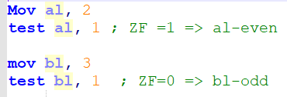
Test instruction
Computes the bit-wise logical AND of first operand (source 1 operand) and the second operand (source 2 operand) and sets the SF, ZF, and PF status flags according to the result.
The result is not saved
We can use TEST to check the parity of an operand:
TEST op, 00000001b
If result of test = 0 then op is even
else op is odd

Slide 10
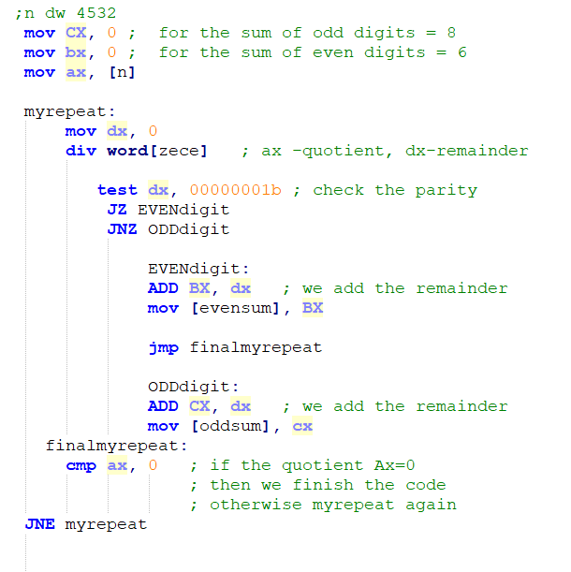
Compute the sum of odd digits and the sum of even digits for a natural number in base 10.

Slide 11
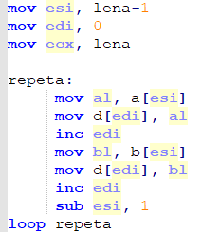
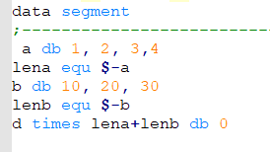
Se dau 2 siruri de bytes a si b egale.
Sa se determine intercalarea elementelor celor 2 siruri de la dreapta la stanga.
a = 1,2,3
b=10,11,12
=>d=3,12,2,11,1,10

